Slide 1

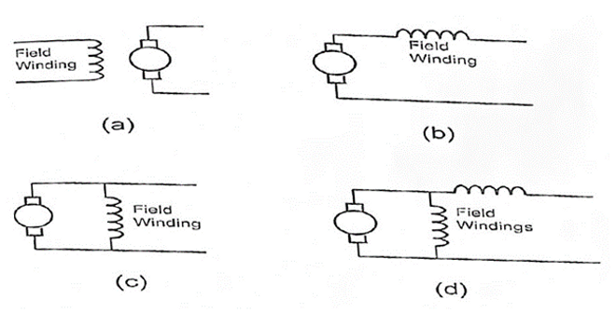
7.2 Speed Control Methods for a DC Motor
Notes:
Let’s break down two practical ways to control the speed of a DC motor

Slide 2
7.2 Speed Control Methods for a DC Motor
Varying the Field Current (Field Control Method):
By inserting a variable resistor (rheostat) in series with the field winding, the current in the field circuit can be reduced.
Increasing the resistance reduces the field current, weakening the magnetic field and increasing motor speed.
Commonly used in shunt motors for speeds above rated speed.
Notes:
First, we have the Field Control Method.

Slide 3
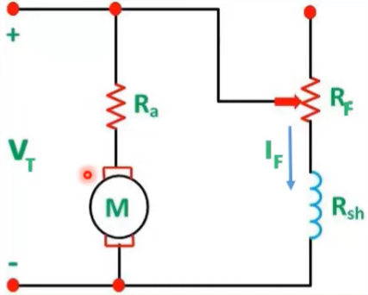
7.2 Speed Control Methods for a DC Motor
Varying the Field Current (Field Control Method):
By inserting a variable resistor (rheostat) in series with the field winding, the current in the field circuit can be reduced.
Increasing the resistance reduces the field current, weakening the magnetic field and increasing motor speed.
Commonly used in shunt motors for speeds above rated speed.
Notes:
This involves placing a variable resistor, or rheostat, in series with the field winding. By adjusting this resistor, we can reduce the current flowing through the field.

Slide 4
7.2 Speed Control Methods for a DC Motor
Varying the Field Current (Field Control Method):
By inserting a variable resistor (rheostat) in series with the field winding, the current in the field circuit can be reduced.
Increasing the resistance reduces the field current, weakening the magnetic field and increasing motor speed.
Commonly used in shunt motors for speeds above rated speed.
Variable Resistor
Notes:
A lower field current means a weaker magnetic field, and that allows the motor to spin faster.

Slide 5
7.2 Speed Control Methods for a DC Motor
Varying the Field Current (Field Control Method):
By inserting a variable resistor (rheostat) in series with the field winding, the current in the field circuit can be reduced.
Increasing the resistance reduces the field current, weakening the magnetic field and increasing motor speed.
Commonly used in shunt motors for speeds above rated speed.
Variable Resistor
Notes:
This method is most effective when you need the motor to run at speeds above its rated speed, and it’s typically used with shunt motors.

Slide 6
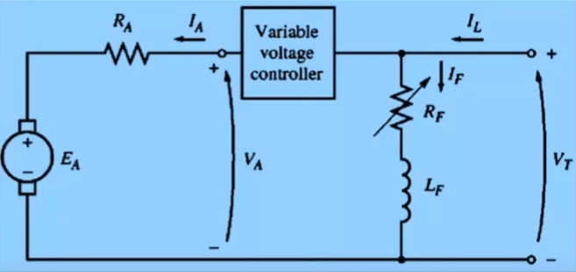
7.2 Speed Control Methods for a DC Motor
2. Varying the Armature Voltage (Armature Control Method):
By using a variable DC power supply or DC drive (thyristor-based controller), the voltage applied to the armature can be adjusted.
Lowering the armature voltage reduces motor speed.
Used for fine speed control below rated speed, suitable for shunt and compound motors.
Notes:
Second, we have the Armature Voltage Control Method.

Slide 7
7.2 Speed Control Methods for a DC Motor
2. Varying the Armature Voltage (Armature Control Method):
By using a variable DC power supply or DC drive (thyristor-based controller), the voltage applied to the armature can be adjusted.
Lowering the armature voltage reduces motor speed.
Used for fine speed control below rated speed, suitable for shunt and compound motors.
Notes:
Here, we use a variable DC supply or a DC drive to directly control the voltage applied to the armature.

Slide 8
7.2 Speed Control Methods for a DC Motor
2. Varying the Armature Voltage (Armature Control Method):
By using a variable DC power supply or DC drive (thyristor-based controller), the voltage applied to the armature can be adjusted.
Lowering the armature voltage reduces motor speed.
Used for fine speed control below rated speed, suitable for shunt and compound motors.
Notes:
By lowering the armature voltage, we reduce the speed of the motor.

Slide 9
7.2 Speed Control Methods for a DC Motor
2. Varying the Armature Voltage (Armature Control Method):
By using a variable DC power supply or DC drive (thyristor-based controller), the voltage applied to the armature can be adjusted.
Lowering the armature voltage reduces motor speed.
Used for fine speed control below rated speed, suitable for shunt and compound motors.
Notes:
This method gives us precise speed control, especially at lower speeds, and is commonly used in shunt and compound motors.

Slide 10
7.2 Speed Control Methods for a DC Motor
2. Varying the Armature Voltage (Armature Control Method):
By using a variable DC power supply or DC drive (thyristor-based controller), the voltage applied to the armature can be adjusted.
Lowering the armature voltage reduces motor speed.
Used for fine speed control below rated speed, suitable for shunt and compound motors.

Slide 11
7.2 Speed Control Methods for a DC Motor
Varying the Field Current (Field Control Method):
By inserting a variable resistor (rheostat) in series with the field winding, the current in the field circuit can be reduced.
Increasing the resistance reduces the field current, weakening the magnetic field and increasing motor speed.
Commonly used in shunt motors for speeds above rated speed.
2. Varying the Armature Voltage (Armature Control Method):
By using a variable DC power supply or DC drive (thyristor-based controller), the voltage applied to the armature can be adjusted.
Lowering the armature voltage reduces motor speed.
Used for fine speed control below rated speed, suitable for shunt and compound motors.
Notes:
In summary, both methods are widely used in practice. Field control is simple and good for increasing speed, while armature voltage control is more advanced and good for fine, stable speed adjustments."

